Slide 1

Making this resource work for you
Prior to teaching this lesson, please refer to the ‘Unit Overview and Planning Document’.
Further guidance on planning Science Mastery lessons can be found in the detailed planning guidance document.
Refer to the ‘notes’ section on each slide for useful information, including suggested expositions, pedagogical content knowledge, suggested questions, answers and more. Consider using presenter mode so you can see this guidance throughout the lesson.
The introduction slides can be adapted to suit your teaching style and the needs of your class.
Before the lesson, adapt the fix-it slide to address any misconceptions identified in the previous lesson’s exit ticket.
Choose from the suggested activities to suit your class. The intention is not that you complete all of these, but that you select those which ones are most appropriate for your students. It may be appropriate to further adapt activities for your students.
These lessons are designed to occupy approximately 1 hour. To adapt for a shorter or longer lesson duration we advise you to adapt the activity section accordingly.
Please consider using the final slide to send feedback about this lesson or examples of PowerPoints that you have adapted to our design team. Your feedback is used to improve Science Mastery for all of our teachers and students. We appreciate all suggestions and comments.
Thank you for reading!
The Science Mastery Team

Slide 2
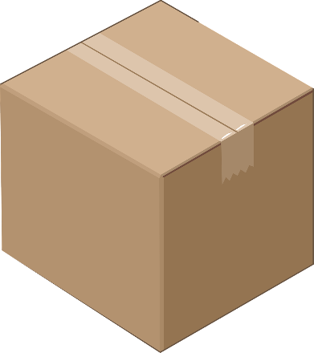
Concentration Calculations Answer the questions below.
How is a solution formed?
Convert 3000 cm³ to dm³
Calculate the relative formula mass of H₂SO₄ .
State the unit of concentration.
Calculate the volume of the box shown.
A solute is dissolved in a solvent.
25 cm
3000 $÷$ 1000 = 3 dm³
(1 x 2) + 32 + (16 x 4) = 98
15 cm
g/dm³
20 cm
7875 cm³ (7.9 dm³)
Notes:
Foundation: What does the word ‘concentration’ mean?
Stretch: Explain the difference between solvent, solute and solution.
Answers:
Foundation: Concentration is the mass of solute per unit volume. OR Concentration is the amount of solute per unit volume.
Stretch: Solute is the soluble substance, the solvent is the liquid in which the solute dissolves and the solution is a mixture of the dissolved solute in the solvent.
Image from pixabay

Slide 3
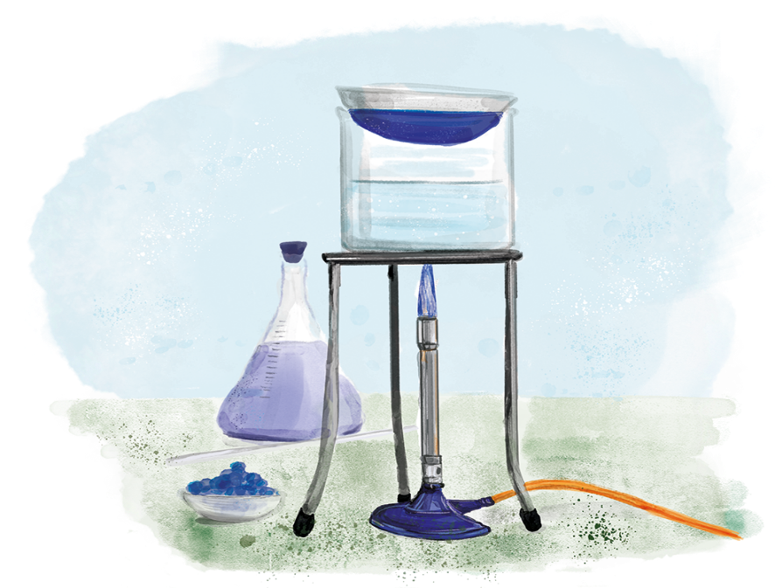

C3.2.8
17/04/2024
Concentration Calculations
C3.2.1 Prior Knowledge Review
C3.2.2 Relative Formula Mass
C3.2.3 Percentage by Mass
C3.2.4 Conservation of Mass
C3.2.5 Balancing Equations
C3.2.6 Uncertainty
C3.2.7 Introducing Concentration
C3.2.8 Concentration Calculations
C3.2.9 Soluble Salts
C3.2.10 Making Soluble Salts
C3.2.11 Making Soluble Salts 2

Slide 4

Following this lesson, students will be able to:
Calculate the concentration of a solution, given the mass of solute and volume of solvent
Rearrange equations
Key Words:
volume
mass
solute
concentration
solution

Slide 5
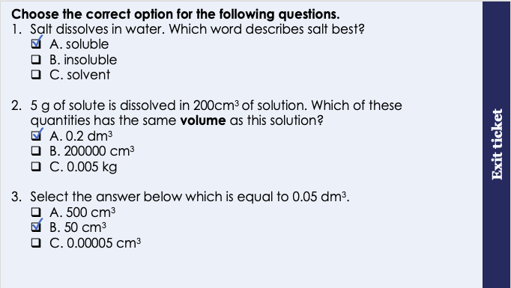
This is the fix-it portion of the lesson
The fix-it is an opportunity to respond to gaps in knowledge, especially those identified by the previous lesson’s exit ticket.
The teacher should customise this slide as needed, to facilitate
reteach, explanation, demonstration or modelling of ideas and concepts that students have not yet grasped or have misunderstood.
practise answering specific questions or of key skills.
redrafting or improving previous work.
Notes:
Purpose: to spend time on any gaps identified in previous learning from exit ticket feedback.
Suggested guidance from previous lesson’s exit ticket:
Q1. Answer: A
Answering B or C suggests that the student is mixing up key terms related to solubility. To fix-it, demonstrate the dissolving of salt in water, narrating as you go using the key terms in the ‘DO Now’ slide of this lesson. Use resources from unit C1.3 to reteach if necessary. Ask students to match the key terms with their definitions, or to assign key terms to the salt, water and salt water.
Q2. Answer: A
Answering B suggests the the student has multiplied by 1000 instead of dividing by 1000 to convert cm³ to dm³. To fix-it, reteach how to convert from one unit to another, using slide 7 to help. Give students some unit conversions to practice.
Answering C suggests that the student has confused volume with mass. To fix-it, reteach the definition of volume, with examples. Compare with mass, and show examples of masses in g and kg.
Q3. Answer: B
Answering A suggests the student has multiplied by 10000 instead of 1000. To fix-it, give the student some more unit conversions to practise. Use slide 7 to reteach the method for converting from one unit to another.
Answering C suggests the student has divided by 1000 instead of multiplying by 1000 to convert dm³ to cm³. To fix-it, reteach how to convert from one unit to another, using slide 7 to help. Give students some unit conversions to practice.

Slide 6
How do we calculate concentration?
The mass of solute found in a solution can be expressed as g/dm³.
This is the mass of solute per dm³ of solution.
The units, g/dm³, give a clue to how to calculate concentration of a solution.
If 6 g of citric acid is dissolved in water to make up 2 000 cm³ of solution, what would the concentration be?
Concentration = mass ÷ volume
= 6 g ÷ 2 dm³
= 3 g/ dm³
The volume needs to be in dm³.
cm³ ÷ 1000 = dm³
÷
Mass
volume
g/dm³
2 000cm³ ÷ 1 000 = 2 dm³
Notes:
Purpose: to introduce new learning.
It is helpful to be able to demonstrate this for students in a practical way as you talk through the slide. Have a solution (say of salt and water) in front of you, to show the solute mass and volume of the solution as an example.
This activity introduces concentration in a quantitative way.
Note: It is incorrect to say: mass of solute dissolved in 1 dm³ of solvent. This is because the volume will increase when the solute is added/ dissolves.

Slide 7
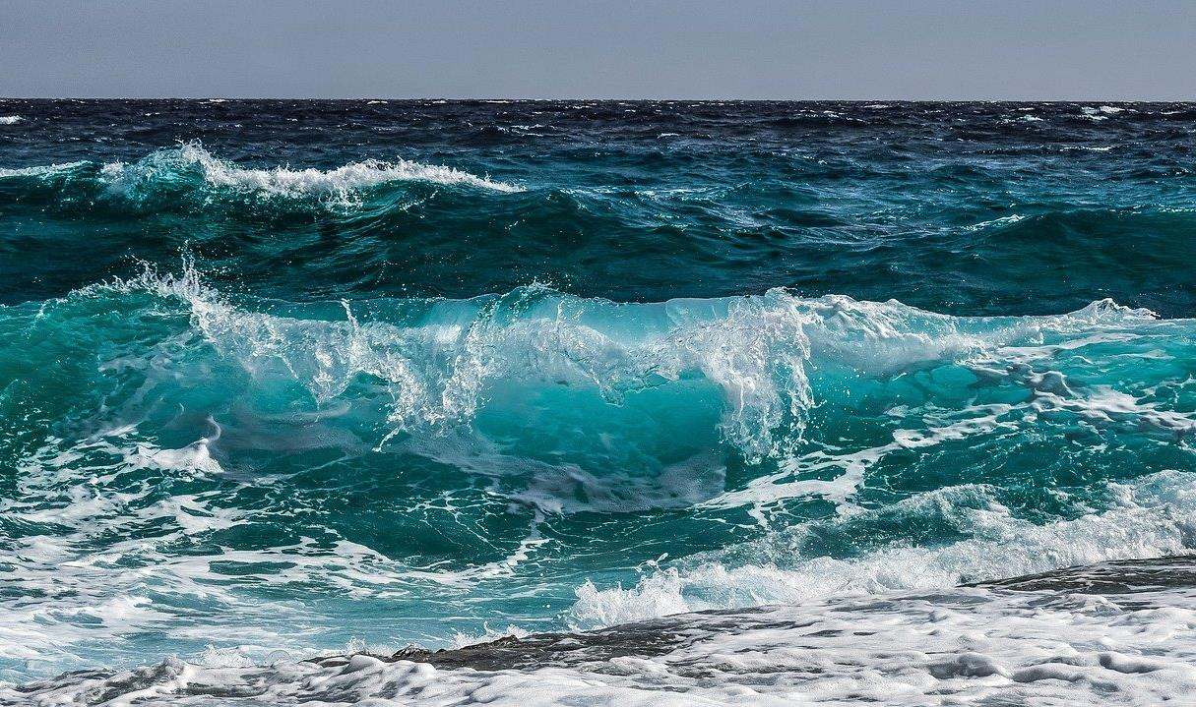
How do we calculate concentration?
Sea water contains about 8.75 g of salt in every 0.25 dm³ of water.
Calculate the salt concentration of the water.
concentration = mass ÷ volume
= 8.75 g ÷ 0.25 dm³
= 35 g/dm³
The volume needs to be in dm³.
✓
Notes:
Purpose: to introduce new learning.
This activity introduces concentration in a quantitative way. Note: only HT Chemistry needs to know mol/ dm³
Note: This topic is closely linked to titrations – which are not part of this unit. The AQA specification statement: ‘If the volumes of the two solutions that react completely are known and the concentration of one solution is known, the concentration of the other solution can be calculated’ is covered in that unit NOT in this one.
Image from pixabay

Slide 8
160 g of sodium hydroxide is used to make 300 cm³ of solution. What is the concentration?
Steps:
What is the question asking?
What information does the question give you?
Write down the correct equation.
Substitute the numbers.
Rearrange the equation if necessary.
Complete the calculation.
Add units.
160 g is the mass of solute
300 cm³ is the volume of the solution
=0.3 dm³
concentration = mass ÷ volume
= 160 g ÷ 0.3 dm³
= 533 g/dm³
Try this one:

Slide 9
Rearranging equations
If I want to get mass by itself, I need to move volume from the right-hand side of the equation to the left.
Because it’s ‘÷ volume’ on the right, it will be ‘x volume’ on the left.
Concentration = mass ÷ volume
Concentration x volume = mass
Mass = concentration x volume
Now we have two equations we can use:
Concentration = mass ÷ volume
Mass = concentration x volume
Notes:
Narrate this slide as you go through the steps to show how equations can be rearranged.
Suggested exposition:
“If you need to calculate concentration, we can see from the formula that concentration = mass ÷ volume. So, to get concentration, we take the mass (in g) and divide it by the volume (in dm³).
But what if you have the concentration, and you have the volume, but you need to find the mass? Now we need to rearrange the equation to find out what to do to find mass. We need mass to be by itself on one side of the equation. [click through the animations once].
If I want to get mass by itself, I need to move volume from the right-hand side of the equation to the left.
Because it’s ‘÷ volume’ on the right, it will be ‘x volume’ on the left. It always changes to the opposite sign when it moves across the equals sign.
So what will we end up with once the volume moves across? [click through the animations once].
Concentration x volume = mass
This is the same as…[click through animations once]: mass = concentration x volume.
We now have an equation to calculate the mass, if we have concentration and volume.

Slide 10
Rearranging equations
If I want to get volume by itself, I need to move concentration from the right-hand side of the equation to the left.
Because it’s ‘x concentration’ on the right, it will be ‘÷ concentration’ on the left.
Mass = concentration x volume
Mass ÷ concentration = volume
Now we have three equations we can use:
Concentration = mass ÷ volume
Mass = concentration x volume
Volume = mass ÷ concentration
Volume = mass ÷ concentration
Notes:
Narrate this slide as you go through the steps to show how equations can be rearranged.
Follow the same steps as in the slide before, to show how we can get volume on its own on one side of the equation.

Slide 11


True or False?
To convert cm³ into dm³ you need to multiply by 1000.
250 cm³ = 0.25 dm³
250 cm³ of a 4 g/dm³ solution contains 1 g of solute.
0.5 dm³ = 5000 cm³
5.5 g of copper sulfate is dissolved in 500 cm³ to form a 11 g/dm³ solution.
False
True
True
False
True
Notes:
Purpose: to check that key knowledge from the introduce phase has been learnt and understood.
You may wish to provide students with white boards to enable them to carry out calculations.
1F; 2T; 3T; 4F; 5T;

Slide 12
Discuss with your partner how you should solve this question. Work together to find the answer. Some glucose was dissolved in 500 cm³ of water. The concentration of the solution was 5g/dm³. What mass of glucose was dissolved in the solution?
Equation: mass = concentration x volume
Numbers: mass = 5 x 0.5
Answer and unit: 2.5 g
Notes:
Suggested guidance:
Talk tasks can be used in a variety of ways to suit the particular needs of the students you are teaching. Through exchanging views with others, students develop their understanding of the science beyond what could be achieved individually.
Science classrooms that successfully integrate talk have the following features:
Science talk is a regular feature of lessons and is woven into classroom activities.
Students are paired or grouped strategically by the teacher to ensure productive interaction. This might take into consideration the students’ proficiency of the English language, how encouraging they might be to peers and their attainment in the topic. It’s a good idea to consider these pairings in the class seating plan.
Students are encouraged and supported to talk, but are not forced to talk.
The teacher should take on the role of a facilitator, engaging with conversations where necessary and encouraging or steering the conversation where needed.
Students are encouraged to use the language they have to express their ideas (e.g., everyday language, imperfect English, native language), but also to incorporate science specific terminology where this is more accurate or has been taught.
6. Scientifically inaccurate ideas are not dismissed by the partner or teacher; open discussion and further investigation are relied on to help students construct ideas that support them to progress in their scientific understanding.
7. Guidelines for behaviour during talk tasks are explicit and frequently reviewed. Rules for students might be:
Listen carefully to your partner
Take turns talking.
Speak one at a time, without interrupting.
Politely agree or disagree and explain why.
Politely point out if your partner has used a scientific word incorrectly, if they have explained the science incorrectly, or if there is a more accurate way to describe something.
If confused, ask questions.
Stay focused on the discussion topic.
Respond to one another.

Slide 13
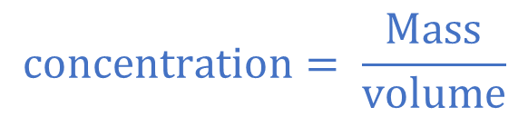
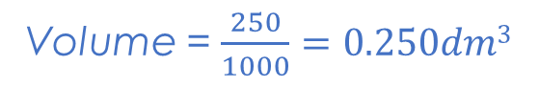
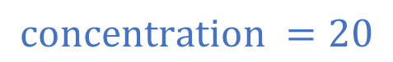
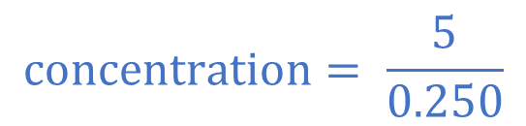
I: Worked example
V
E
S
C
U
5g of sodium hydroxide, NaOH is dissolved in 250 cm³ of water
Calculate the concentration of NaOH.
concentration= ?
mass = 5g
Volume = 250cm³
Volume = $\frac{250}{1000}=0.250dm3$
$$concentration= \frac{Mass}{volume}$$
$$concentration= \frac{5}{0.250}$$
$$concentration =20$$
g/dm³

Slide 14
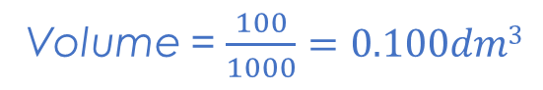
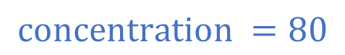
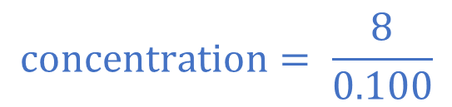
We: Worked example
V
E
S
C
U
8g of calcium hydroxide, Ca(OH)₂ is dissolved in 100 cm³ of water
Calculate the concentration of Ca(OH)₂ .
concentration= ?
mass = 8g
Volume = 100cm³
Volume = $\frac{100}{1000}=0.100dm3$
$$concentration= \frac{Mass}{volume}$$
$$concentration= \frac{8}{0.100}$$
$$concentration =80$$
g/dm³

Slide 15
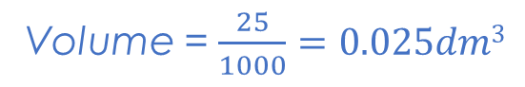
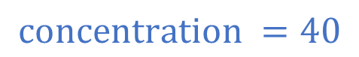
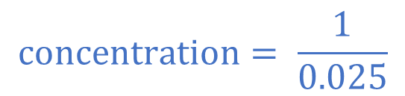
You: Worked example
V
E
S
C
U
1g of calcium hydroxide, Ca(OH)₂ is dissolved in 100 cm³ of water
Calculate the concentration of Ca(OH)₂ .
concentration= ?
mass = 1g
Volume = 25cm³
Volume = $\frac{25}{1000}=0.025dm3$
$$concentration= \frac{Mass}{volume}$$
$$concentration= \frac{1}{0.025}$$
$$concentration =40$$
g/dm³

Slide 16
Drill
What are the units for concentration?
What are the units for volume?
What are the units for mass?
50 g of sugar is dissolved in 1dm ³ of water. What is the concentration? Give units
50 g of sugar is dissolved in 1litre of water. What is the concentration? Give units
Link concentration, mass and volume in an equation where concentration is the subject.
Link concentration, mass and volume in an equation where mass is the subject.
Link concentration, mass and volume in an equation where volume is the subject.
Notes:
Purpose: This is a knowledge drill. The purpose of this is to check that the critical knowledge is secure before pupils move onto independent practice.
Suggested guidance: There are a range of ways this could be done depending on time and ability range of the class:
Mini whiteboards
As full sentences in exercise books
As short answers in exercise books
In the pupil workbook
As pair talk
As cold call

Slide 17
Drill answers
g/dm³
dm³
g
50 g/dm³
50 g/dm³
Concentration = mass
volume
Mass= concentration x volume
Volume = concentration
volume
Notes:
Purpose: This is a knowledge drill. The purpose of this is to check that the critical knowledge is secure before pupils move onto independent practice.
Suggested guidance: There are a range of ways this could be done depending on time and ability range of the class:
Mini whiteboards
As full sentences in exercise books
As short answers in exercise books
In the pupil workbook
As pair talk
As cold call

Slide 18
Calculating Concentration
Complete the calculation worksheet.
Concentration (g/dm³) = mass (g)
volume (dm³)
Notes:
Purpose: students practise using and applying their new knowledge. Mark schemes are given where possible for students to self or peer assess work.

Slide 19
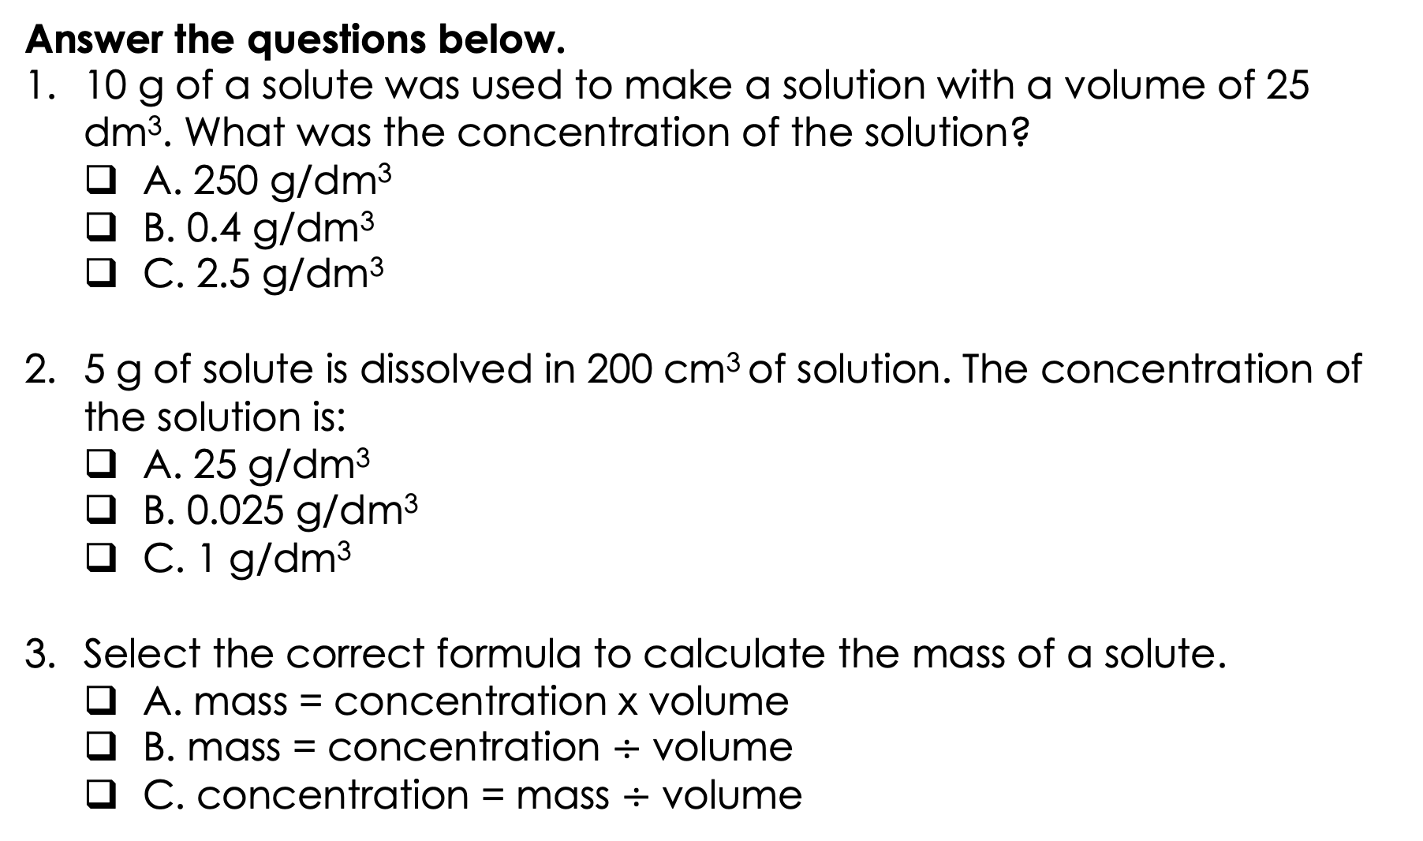
Answer the questions below.
10 g of a solute was used to make a solution with a volume of 25 dm³. What was the concentration of the solution?
A. 250 g/dm³
B. 0.4 g/dm³
C. 2.5 g/dm³
5 g of solute is dissolved in 200 cm³ of solution. The concentration of the solution is:
A. 25 g/dm³
B. 0.025 g/dm³
C. 1 g/dm³
Select the correct formula to calculate the mass of a solute.
A. mass = concentration x volume
B. mass = concentration $÷$ volume
C. concentration = mass $÷$ volume
✓
✓
✓
Notes:
Q1. Answer: B
If students answer A, it suggests that they have multiplied the mass and volume instead of dividing. If students answer C, it suggests that they have divided volume by mass instead of the other way around. To fix-it, remind the student of the correct formula to calculate concentration. Model the method to work this calculation out, and then give the student some similar calculations to try.
Q2. Answer: A
If students answer B, it suggests that they have used the volume in cm³ and has not converted to dm³. If students answer C, it suggests that they have multiplied he mass and the correct volume, instead of dividing these as needed. To fix-it, remind the student of the correct formula to calculate concentration and the need to convert to dm³. Model the method to work this calculation out, and then give the student some similar calculations to try.
Q3. Answer: B
If students answer A or C, it suggests that they are having difficulty rearranging the correct equation. To fix-it, reteach how this is done using slides 9 and 10, and give the student some practice calculations to apply this learning.

Slide 20
Lesson C3.2.6
What was good about this lesson? | What can we do to improve this lesson?
Send us your feedback by clicking this link
or by emailing sciencemastery@arkonline.org
Thank you!

